Slide 1
ESA SSA Roadmap for the L5 Mission
Juha-Pekka Luntama
Nicolas Bobrinsky
Stefan Kraft
L5 in Tandem with L1: Future Space-Weather Missions Workshop
6-9 March 2017

Slide 2
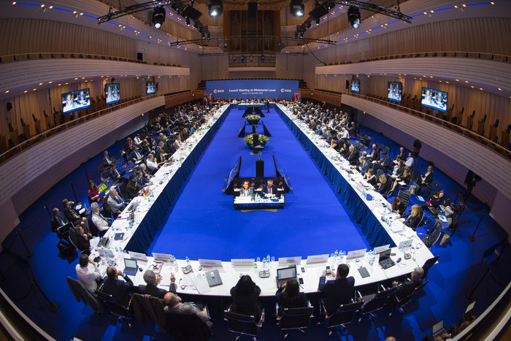
ESA SSA Programme
Objective:
Protection of space and ground assets against adverse effects from space
SSA Programme initiated in April 2008 SSA Programme executed in Periods
Period 1 decided at MC in November 2008
Period 2 decided at MC12 in November 2012
Period 3 decided in MC16 in December 2016
SSA SWE Lagrange Mission support
7 Participating States in the LGR mission segment in SSA Period 3
Lagrange mission Phase A/B studies and instrument pre-developments funded

Slide 3
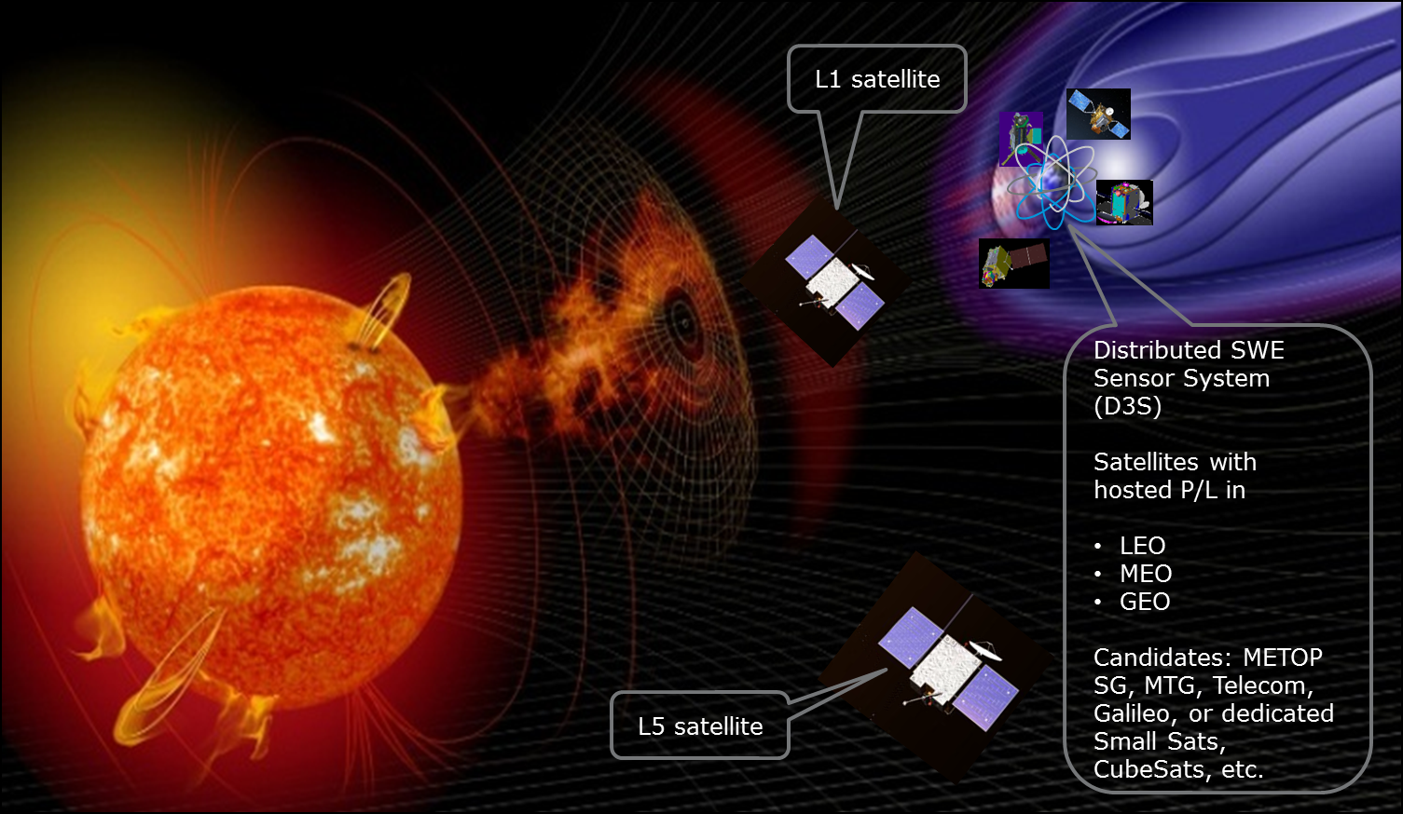
Enhanced SWE observation system

Slide 4
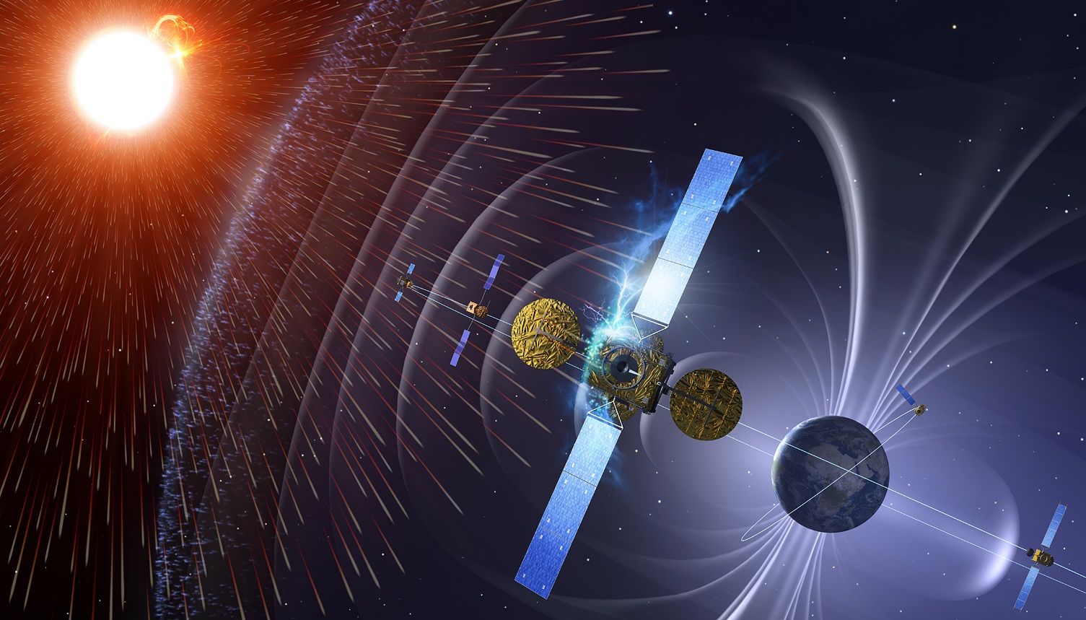
SSA SWE Lagrange Mission Roadmap
Consolidation of MRD/SRD for Phase A/B1
Mission target consolidation
ITT preparation
ITT preparation
Launch
Operation
MAR
MDR
PRR
SRR
PDR
CDR
FAR
Phase 0 L1
Phase A/B
Phase C/D
LEOP / Transfer
Phase 0 L5
Instrument pre-developments to TRL 6
Instrument procurement
Two parallel Phase A/B1 studies
Single study to complete Phase A/B
Satellite procurement
Ground Segm. procurement
2016
2017
2018
2019
2020
2021
2022
2023
2024
Period 2
Period 3
Period 4
Period 5

Slide 5
Summary
SSA Program has a mandate and funding to continue L1/L5 mission development
Mission target consolidation needed in 2018
The objective is to complete Phase A/B studies by end 2019
Phase C/D proposal to be submitted to ESA MC19
Launch foreseen in 2023
One year transfer phase to L5
=> Mission in operation in 2024

Slide 6


THANK YOU
swe.ssa.esa.int
www.esa.int

